Slide 1

Computer System Servicing

Slide 2
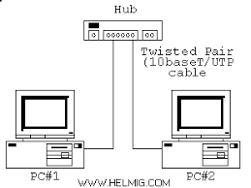
Motivation:

Slide 3
Creating Straight-Through Cable

Slide 4
Straight-Through Cable
A type of twisted pair cable that is used in local area network to connect a computer to a network hub.

Slide 5

Steps in Creating Straight-Through Cable
1. Prepare the tools and materials.

Slide 6
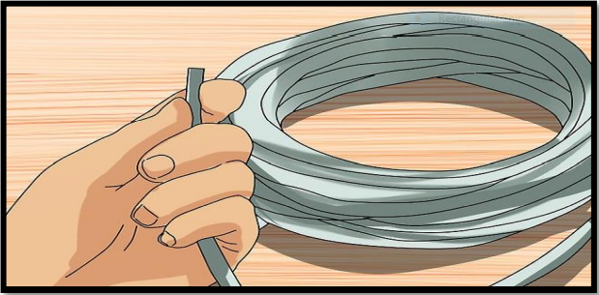
Steps in Creating Straight-Through Cable
2. Cut the twisted-pair cable based on the needed length.

Slide 7
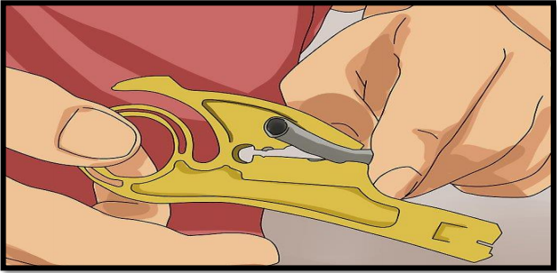
Steps in Creating Straight-Through Cable
3. Remove the outer jacket of the cable to expose the four pairs of wire inside.

Slide 8
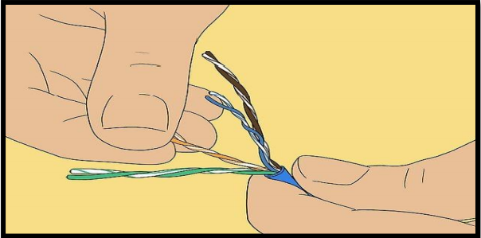
Steps in Creating Straight-Through Cable
4. Untwist the wires, make sure that they are free from any damage.

Slide 9
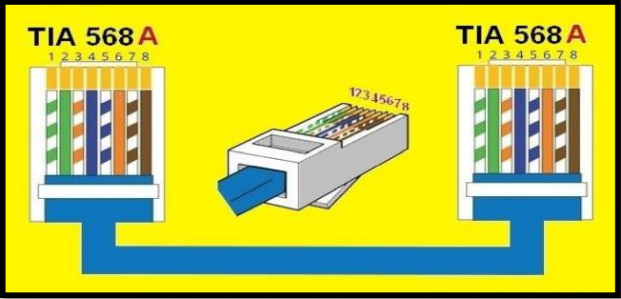
Steps in Creating Straight-Through Cable
5. Arrange the wire based on the type of cable. (Straight-Through Cable – T568-A)

Slide 10
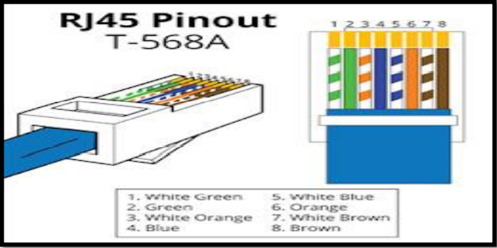
T568-A

Slide 11
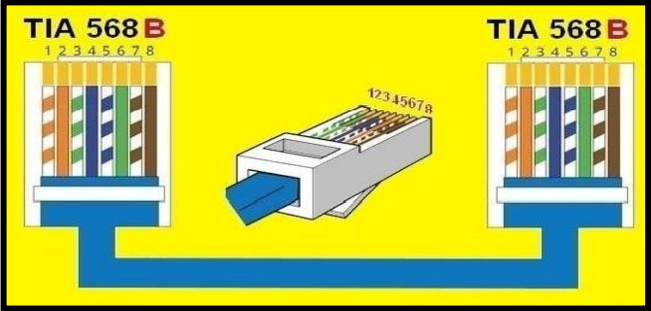
Steps in Creating Straight-Through Cable
5. Arrange the wire based on the type of cable. (Straight-Through Cable – T568-B)

Slide 12
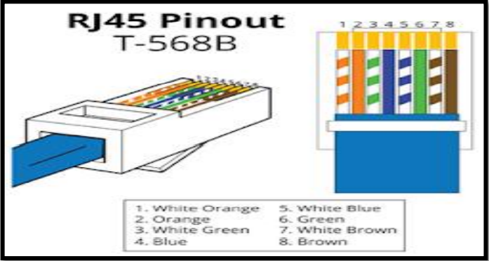
T568-B

Slide 13
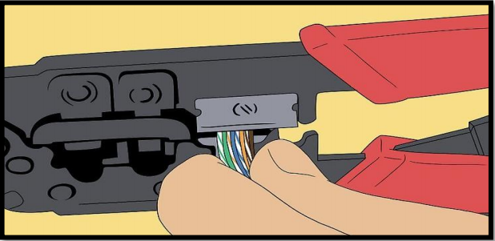
Steps in Creating Straight-Through Cable
6. Cut the wires so that they will be of exact length, make sure that the ends of the wires are aligned.

Slide 14
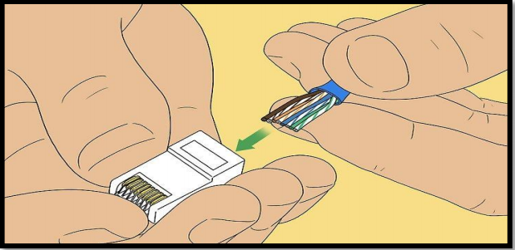
Steps in Creating Straight-Through Cable
7. Firmly hold the cable and insert the wires into the RJ45 jack.

Slide 15
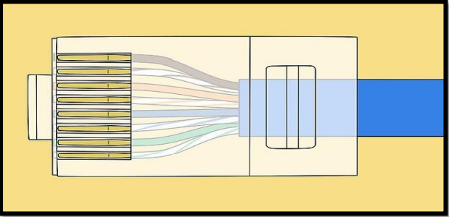
Steps in Creating Straight-Through Cable
8. Check if the end of the wires touches the end of the RJ45 jack.

Slide 16
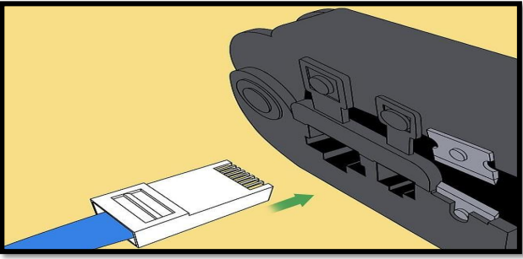
Steps in Creating Straight-Through Cable
9. Plug the cable into the crimping tool, firmly squeeze it while securely holding the cable.

Slide 17
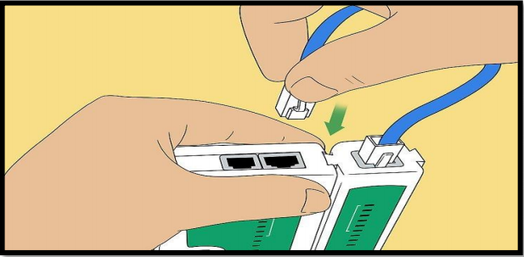
Steps in Creating Straight-Through Cable
10. Use a LAN Tester to ensure that the connection of all wires in both ends of the cable.

Slide 18
FORMATIVE ASSESSMENT
Direction: Arrange the following sequence of steps in creating straight-through cable.
Write numbers 1-10 on the blank line.

Slide 19
FORMATIVE ASSESSMENT
__ Use a LAN tester to ensure that the connection of all wires in both ends of the cable.
__ Prepare the tools and materials.
__ Plug the cable into the crimping tool, firmly squeeze it while securely holding the cable.
__ Cut the twisted-pair cable based on the needed length.
__ Check if the end of the wires touches the end of the RJ45 jack.
__ Remove the outer jacket of the cable to expose the four pairs of wires inside.
__ Firmly hold the cable and insert the wires into the RJ45 jack.
__ Untwist the wires, make sure that they are free from any damage.
__ Cut the wires so that they will be of exact length, make sure that the ends of the wires are aligned.
__ Arrange the wires based on the type of cable.

Slide 20
Practical Application of the acquired
Learning Competencies

Slide 21

GENERALIZATION

Slide 22
THANK YOU!!!

